Slide 1
Mobile Node Pilot Progress
Fernando Gros González
04-03-2013

Slide 2
Outline
What has been done so far
Contribution and future tasks
BattleMesh v6 proposal

Slide 3
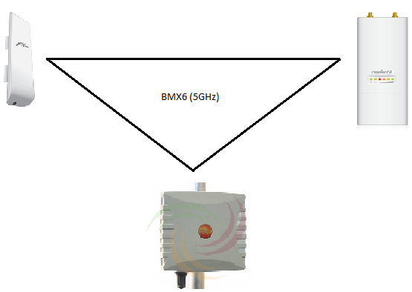
What has been done so far
Install QMP and deploy a Mesh
A mesh network has been deployed in the lab using three different devices with qmp firmware.

Slide 4
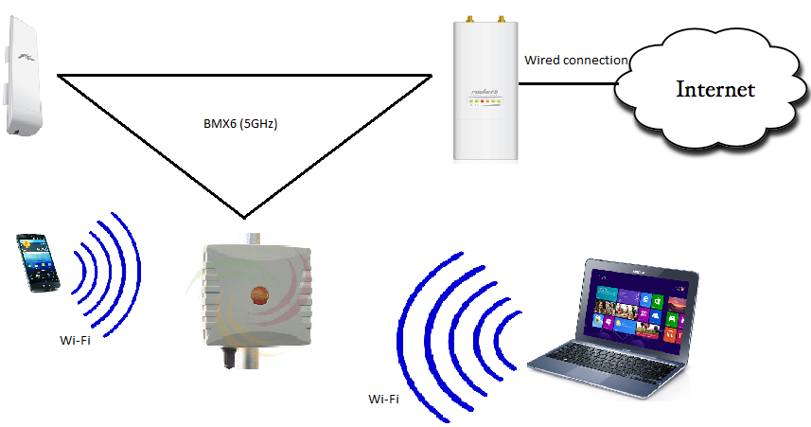
What has been done so far
Add a gateway and check Internet connectivity
Using this network, one of the nodes has been connected to the Internet and any client attached to the other nodes in the network can access to it. Different distances among the nodes have been successfully tested.

Slide 5
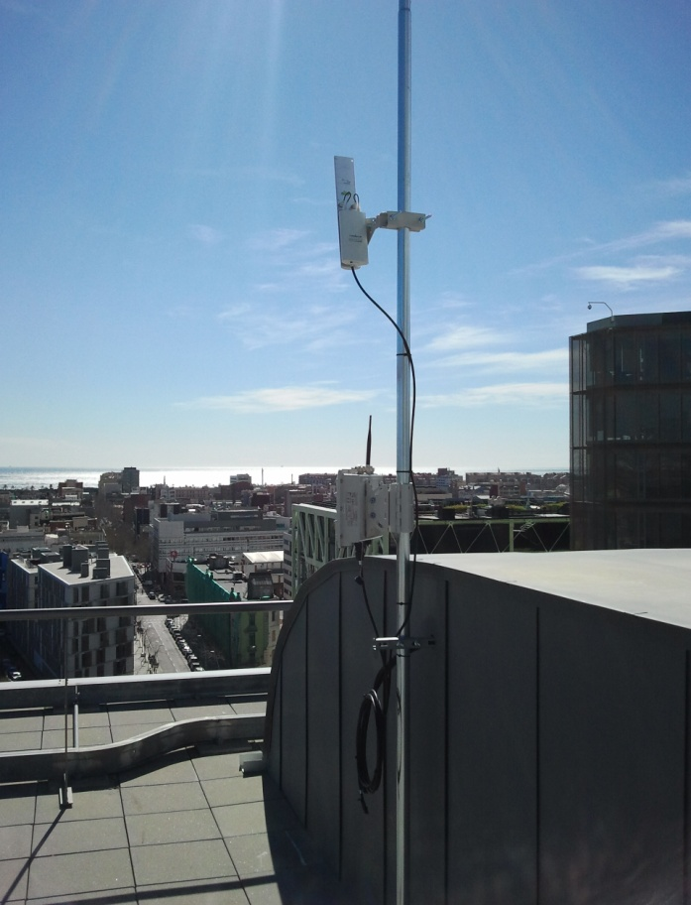
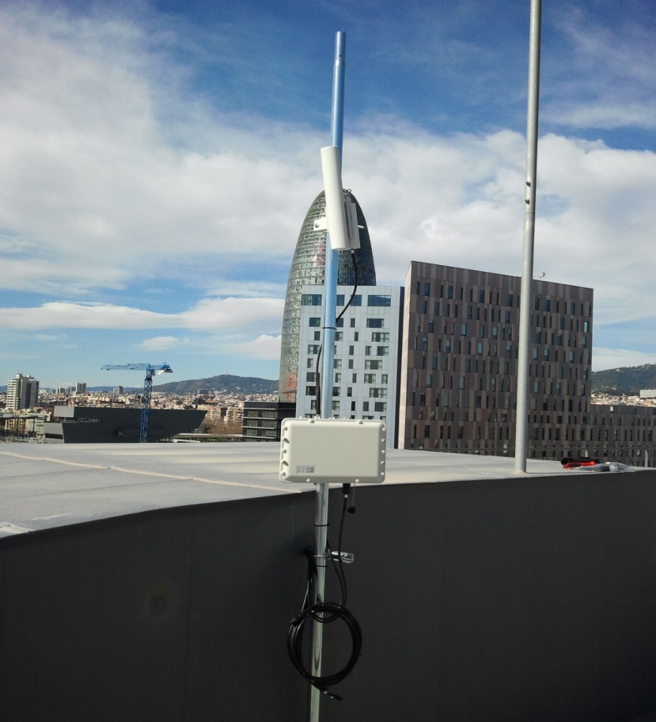
What has been done so far
Install Rocket M5 on Roc Boronat building’s roof
The node has been installed on the roof pointing to Poblenou neighborhood. It will contribute to the Mesh network which is currently being deployed in this zone.

Slide 6
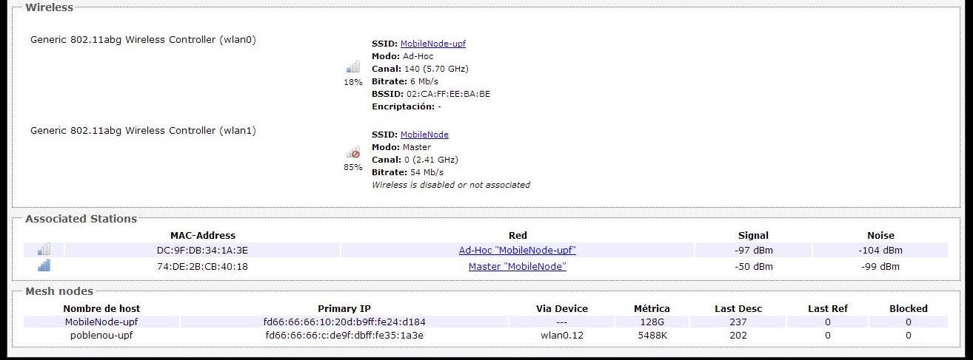
What has been done so far
Test connection between Rocket and Mobile Node (alix)

Slide 7
Contribution and future tasks
The contribution of this TFG is on the one hand, expanding the network being deployed in Poblenou neighborhood and on the other hand has to be decided yet.
Some options has been already considered:
Contribute on the dissemination of the whole project behind
Develop an app that locate all the fixed qmp nodes on a map
The future tasks are:
Decide and implement the contribution
Write up the thesis with the detailed information

Slide 8
BattleMesh v6 proposal
My proposal is to provide an update of how the BuB branch of C4EU project is going on. The last advances and news.
In addition, explain my pilot in a more detailed way to the attendees.
Try to get inputs and ideas from the whole event

Slide 9
Thank you for your time!

